Slide 1
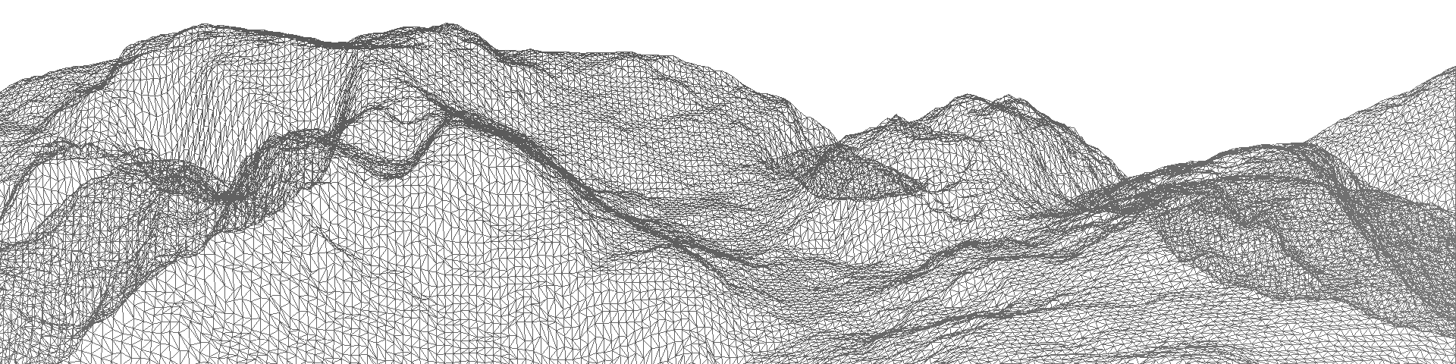
Numerical representation of mountains in atmospheric models
Galerkin methods with applications in weather and climate forecasting
A like-for-like comparison of terrain following layers and cut cell grids
James Shaw
Hilary Weller, John Methven, Terry Davies

Slide 2
Numerical representation of mountains in atmospheric models
Effects of orography on the weather
Representation in numerical weather prediction (NWP) models
Like-for-like comparison between terrain following and cut cell grids

Slide 3
Effects of orography on the weather

Slide 4
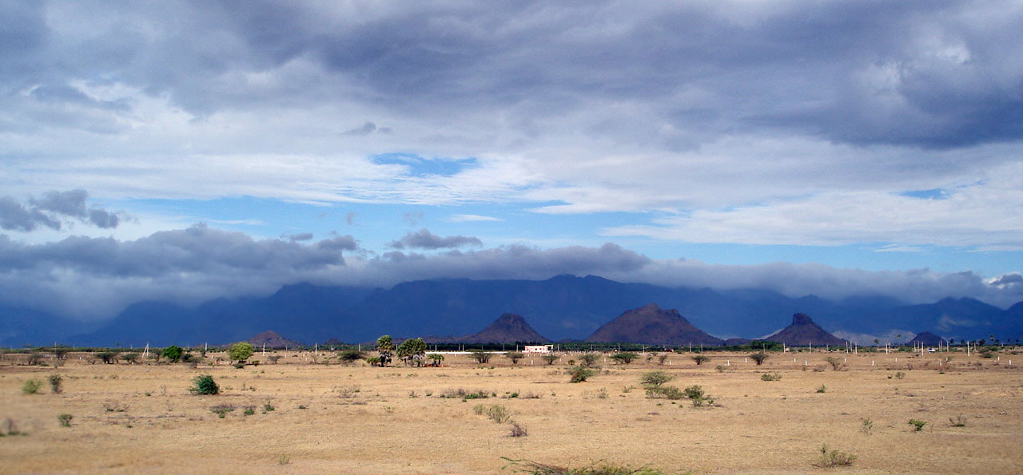
Effects of orography on the weather Local precipitation patterns
Source: Arun Ganesh, CC BY-SA 3.0

Slide 5
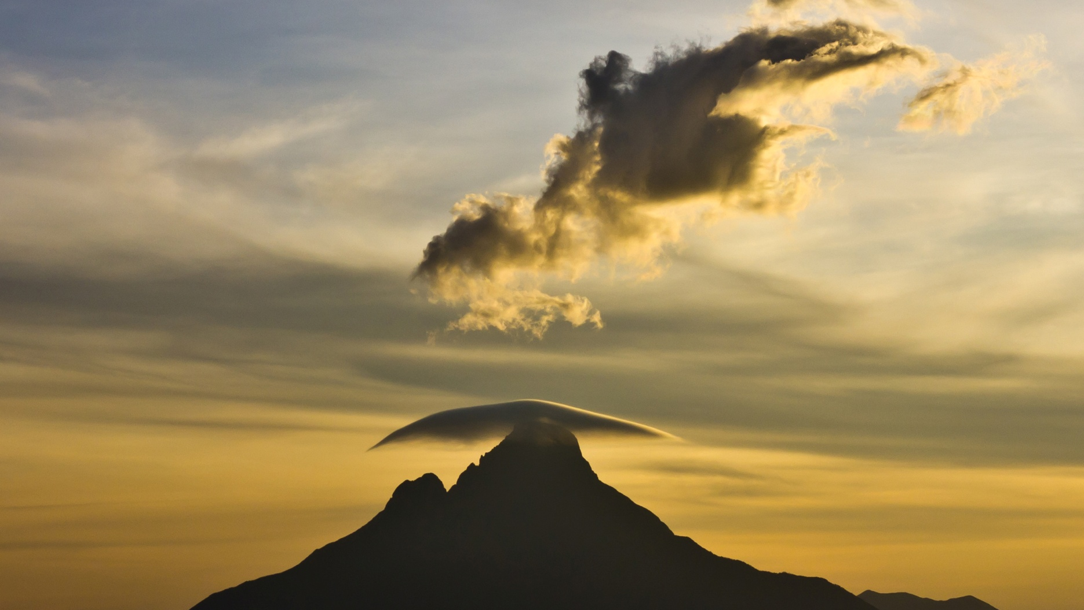
Effects of orography on the weather Lenticular clouds
Source: Cai Tjeenk Willink, Public domain
Notes:
The summit of Mont Mikeno in the Virunga Mountains. Altocumulus lenticularis clouds form around the top of the mountain.

Slide 6
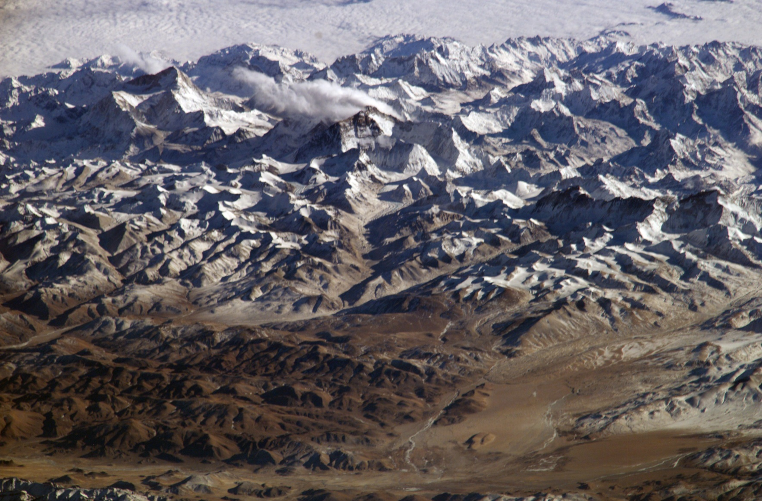
Effects of orography on the weather Elevated heat source
Source: NASA, Public domain
Notes:
Himilayas from Tibetan Plateau

Slide 7
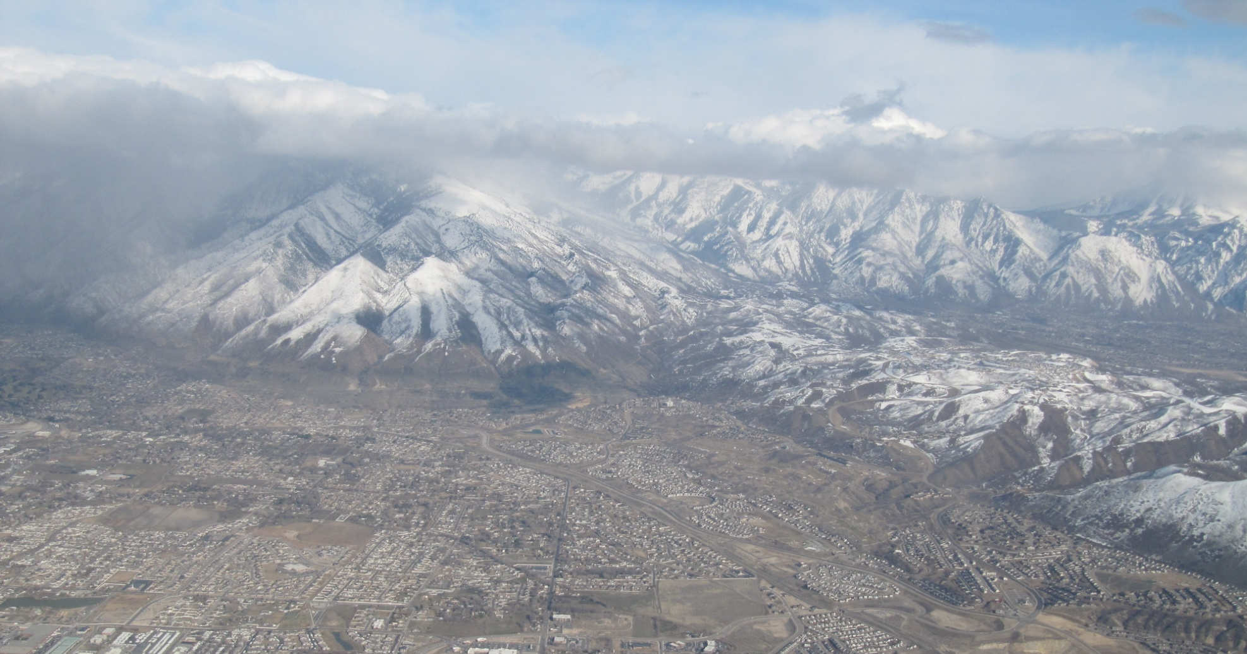
Effects of orography on the weather Thermally Driven Circulation
Source: Rick Willoughby, CC BY 2.0
Notes:
Salt lake valley

Slide 8
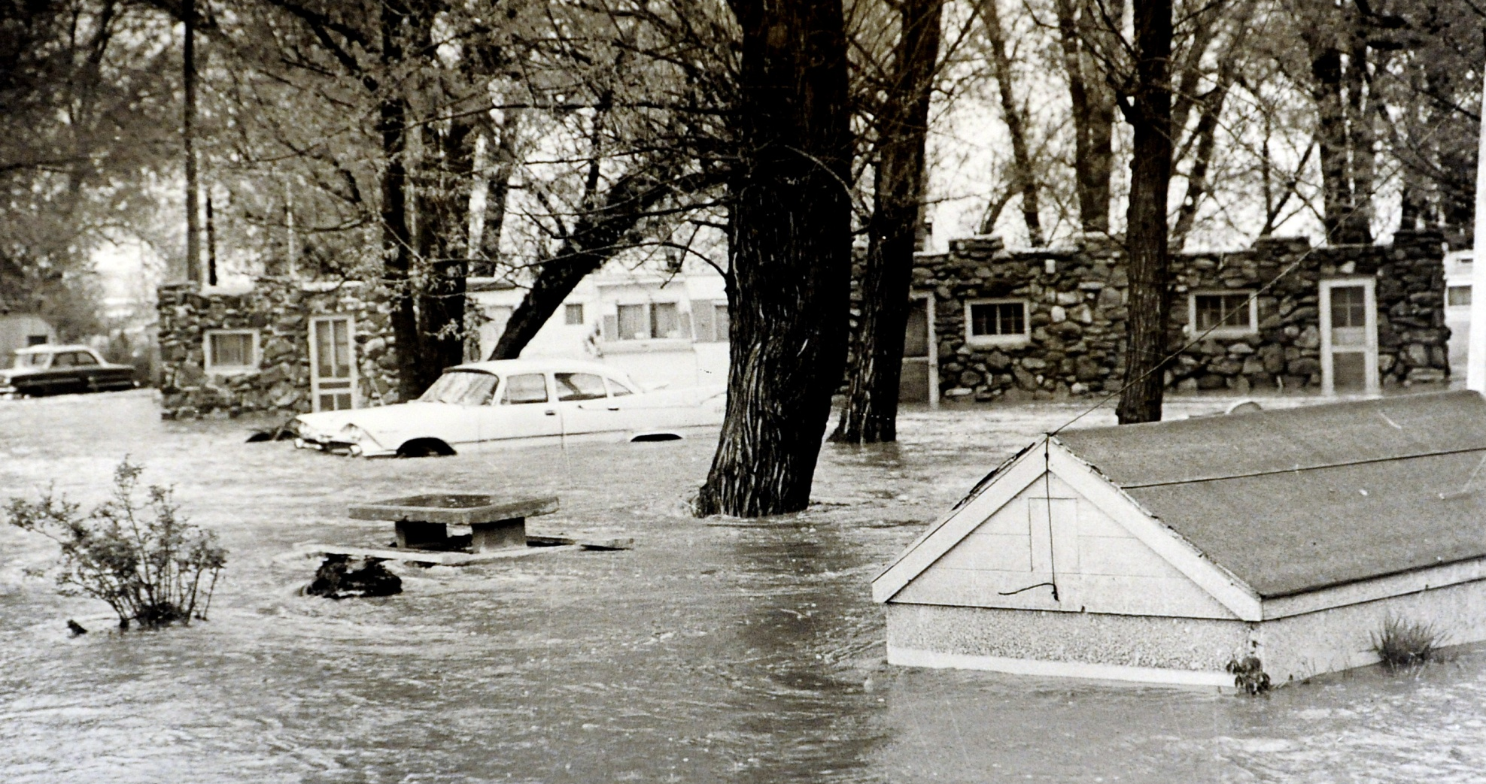
Effects of orography on the weather Downslope windstorms
Source: Boulder Daily Camera

Slide 9
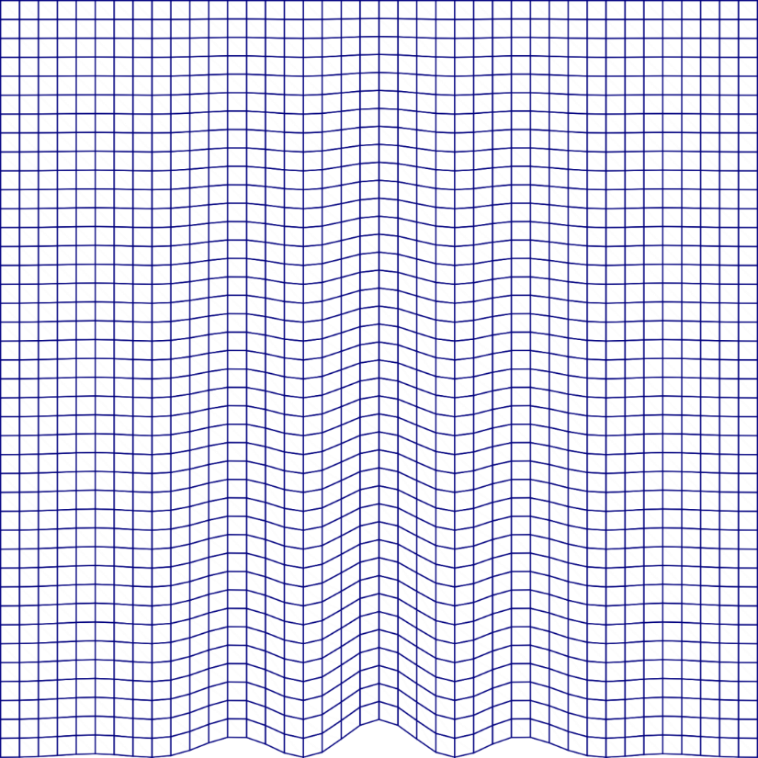

Representation in NWP Models
Terrain following layers
Cut cells

Slide 10
Terrain following layers
Basic terrain following (BTF)
Hybrid terrain following (HTF)
Smooth LEvel VErtical (SLEVE)
Optimized SLEVE
Smoothed Terrain Following (STF)
(Gal-Chen & Somerville 1975 JCP)
(Simmons & Burridge 1981 MWR)
(Schär et al. 2002 MWR)
(Leuenberger et al. 2010 MWR)
(Klemp 2011 MWR)

Slide 11
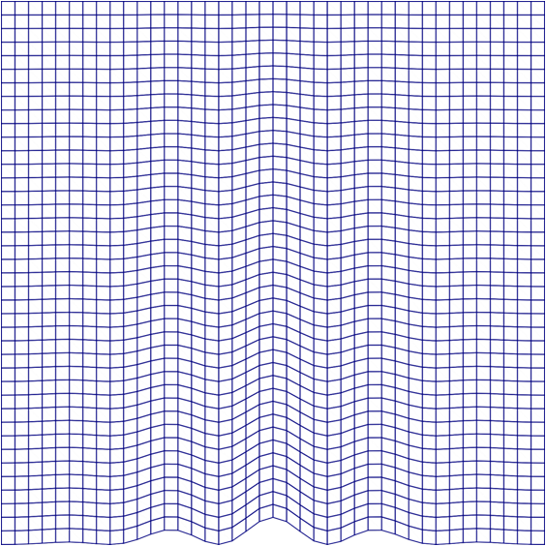
Terrain following layers Basic Terrain Following

Slide 12
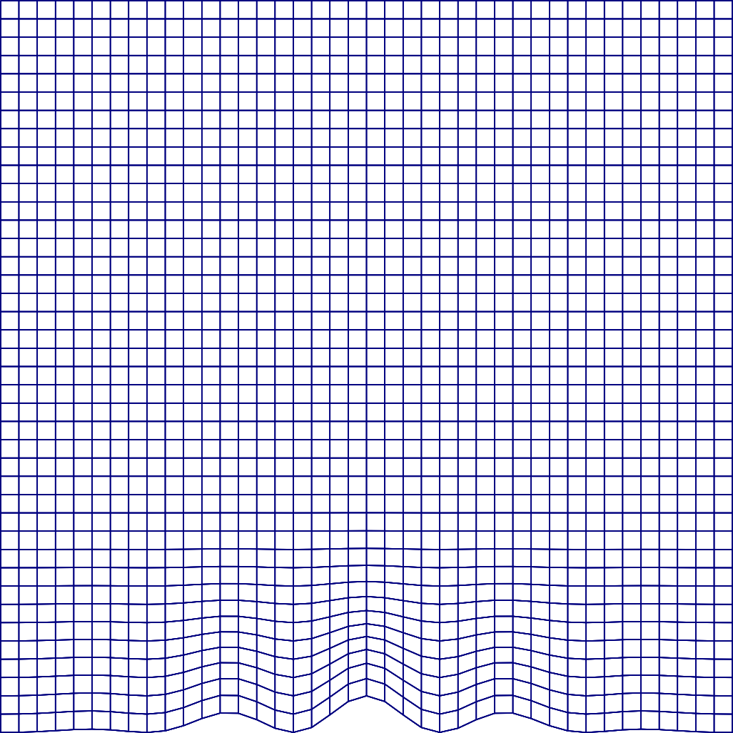
Terrain following layers Hybrid Terrain Following

Slide 13
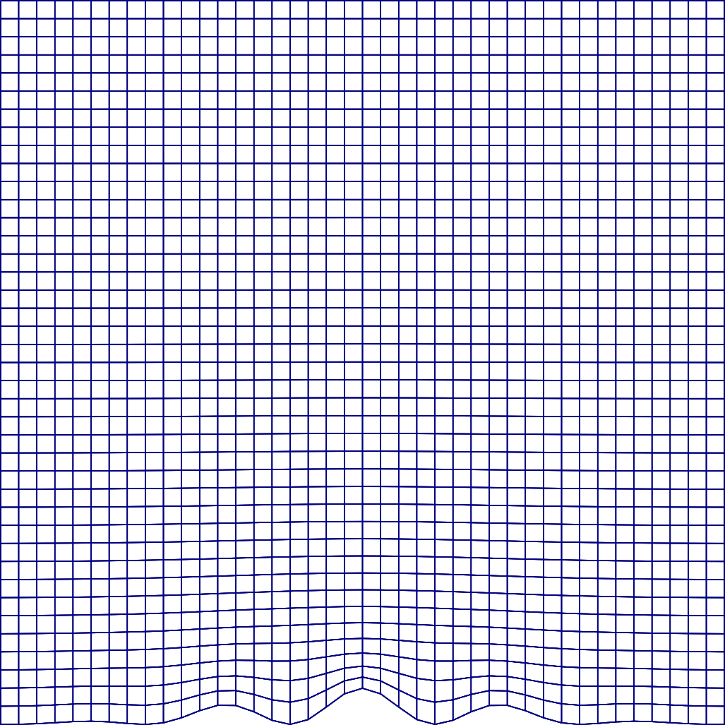
Terrain following layers Optimized SLEVE

Slide 14
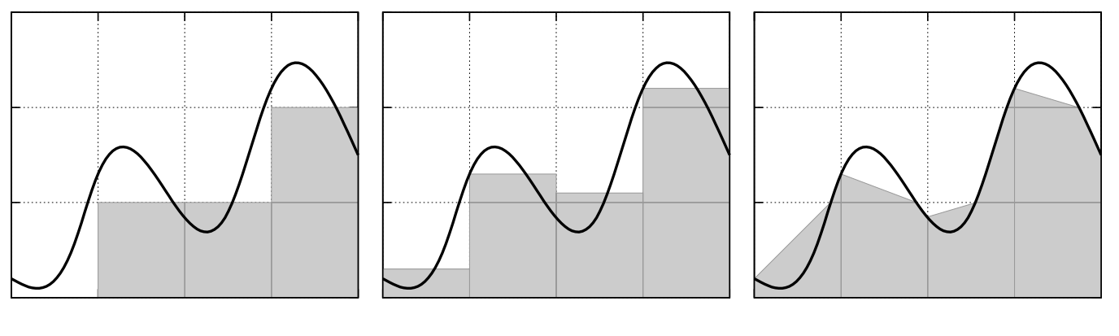
Cell Shaving Methods
Full step
(Mesinger et al. 1988 MWR)
Partial step
(Adcroft et al. 1997 MWR)
Piecewise linear

Slide 15
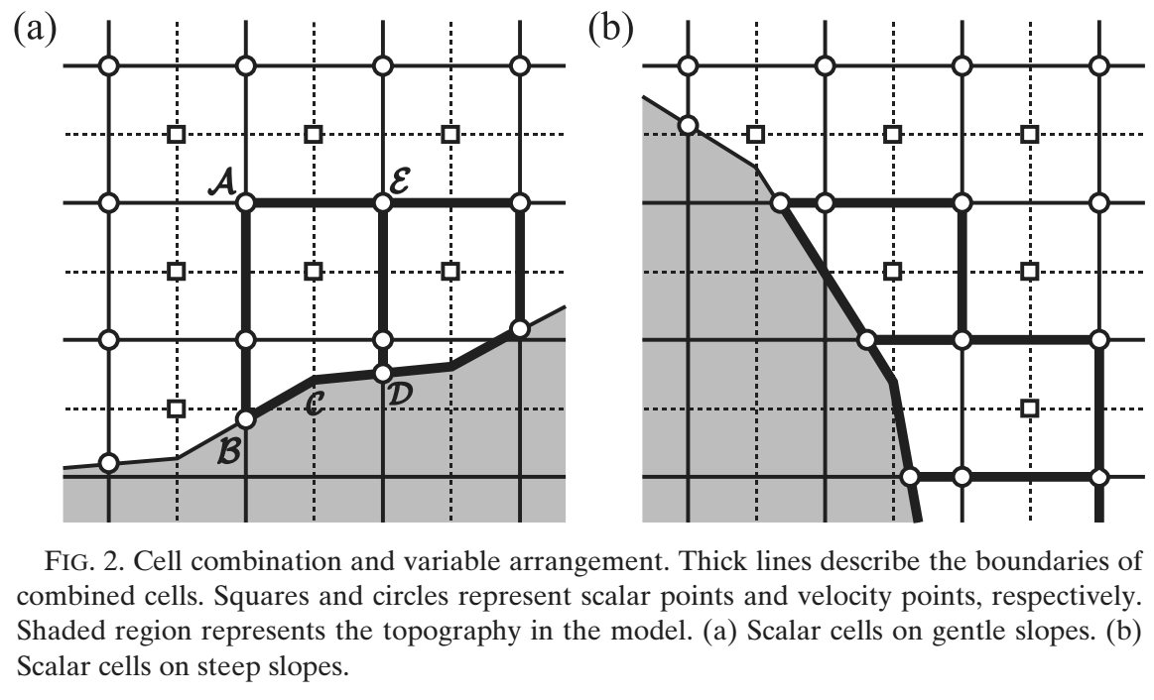
Cell shaving methods Small Cell problem
Combine cells (shown below) (Yamazaki & Satomura 2010 MWR)
Increase computational volume (Steppeler et al. 2002 MWR)
Implicit solver in regions of shaved cells (Jebens et al. 2011 JCP)

Slide 16
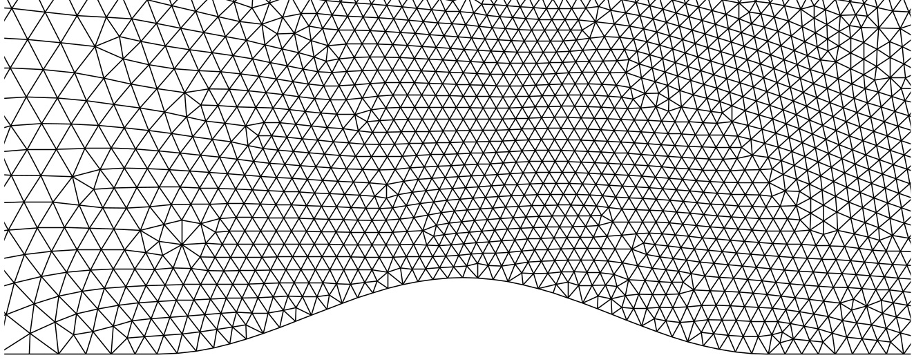
And Others
Source: Smolarkiewicz & Szmelter
http://ral.ucar.edu/hap/events/orographic-precip/images/2wed/am/day2-Wed_am_3-Orogunmesh2.ppt

Slide 17
Like-for-Like comparison OF TF Layers and Cut Cell grids

Slide 18
Test Cases
Horizontal tracer advection (Schär et al. 2002 MWR)
Terrain following tracer advection
Resting atmosphere (Klemp 2011 MWR)
Orographically induced gravity waves (Schär et al. 2002 MWR)

Slide 19
Advection scheme
Using advection scheme from Weller & Shahrokhi 2014 MWR
Multidimensional cubic
Upwind-biased
Non-monotonic

Slide 20
#1 Horizontal Tracer Advection

Slide 21
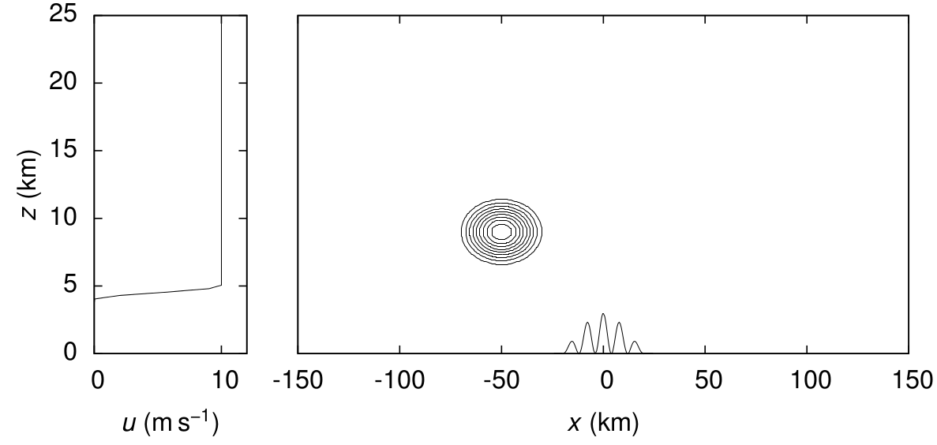
#1 Horizontal Tracer Advection Initial Conditions
Horizontal wind profile, surface terrain profile and initial tracer Adapted from Schär et al. 2002 MWR

Slide 22
#1 Horizontal Tracer Advection Results
Compare
Centred difference scheme
Cubic upwind-biased scheme, Weller & Shahrokhi 2014 MWR
On the grids
Basic terrain following
SLEVE
Cut cell

Slide 23
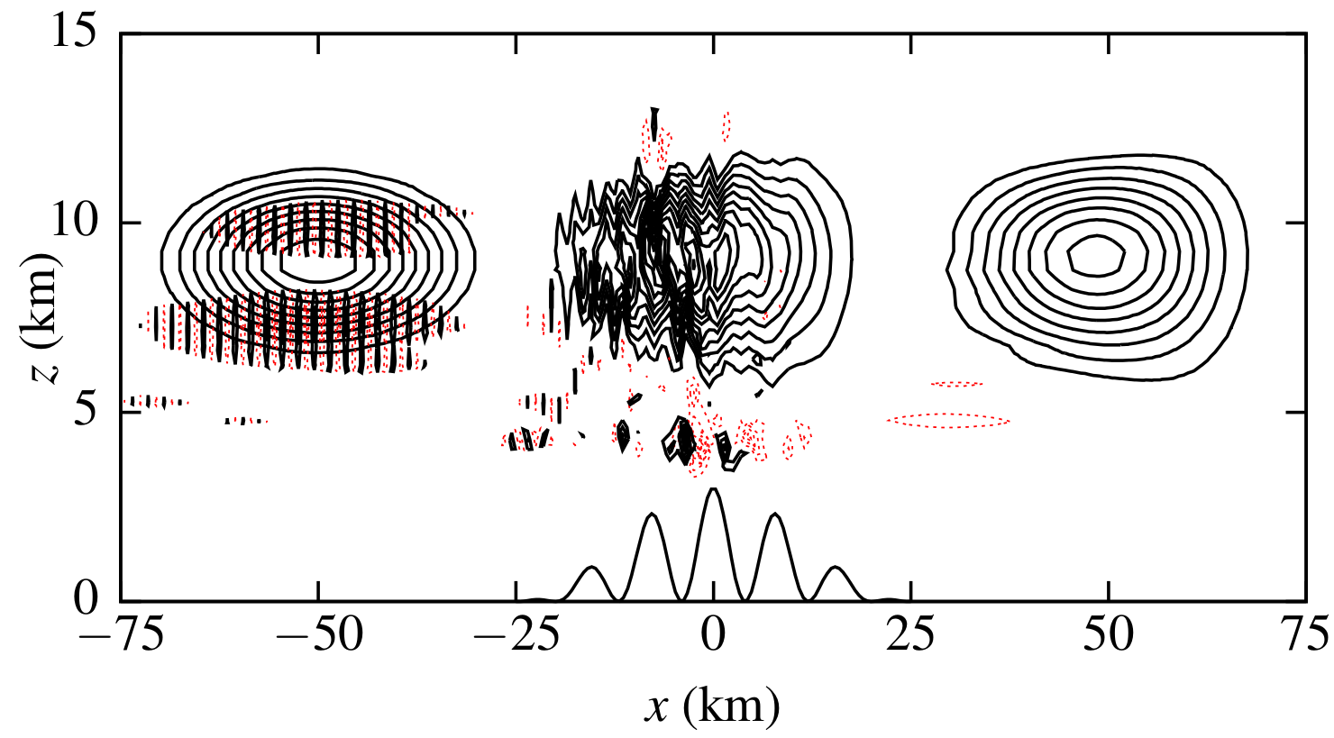
#1 Horizontal Tracer Advection Basic terrain following grid
Centred scheme on BTF grid

Slide 24
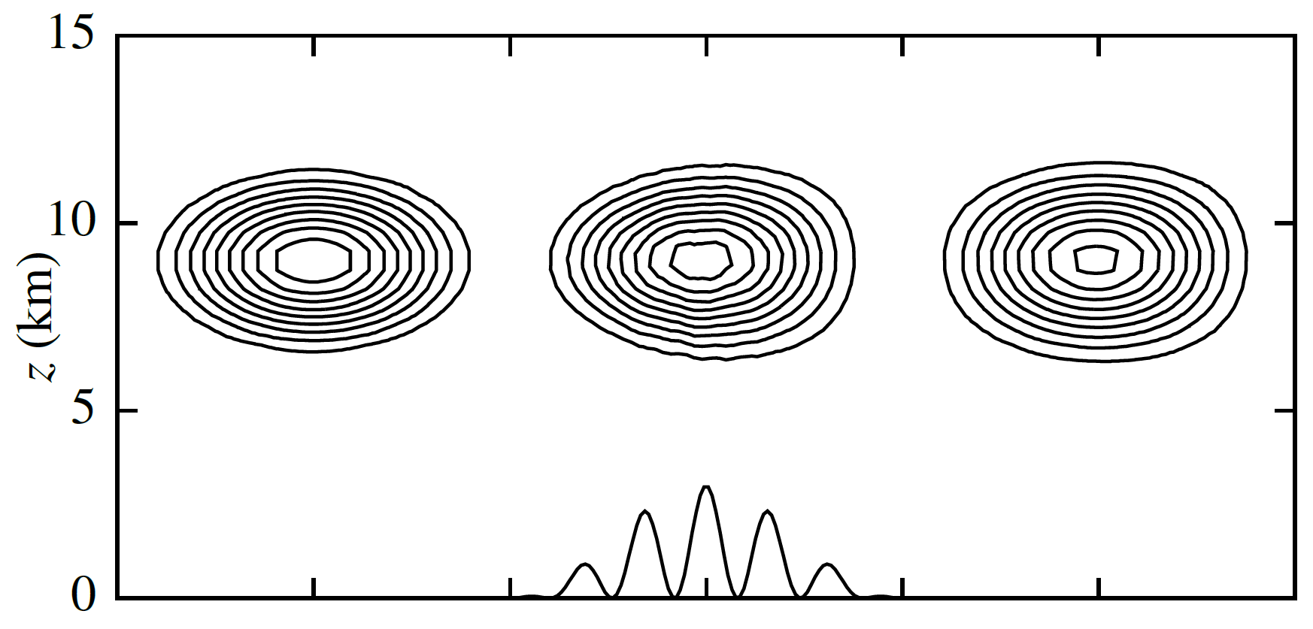
#1 Horizontal Tracer Advection Basic terrain following grid
Cubic upwind scheme on BTF grid

Slide 25
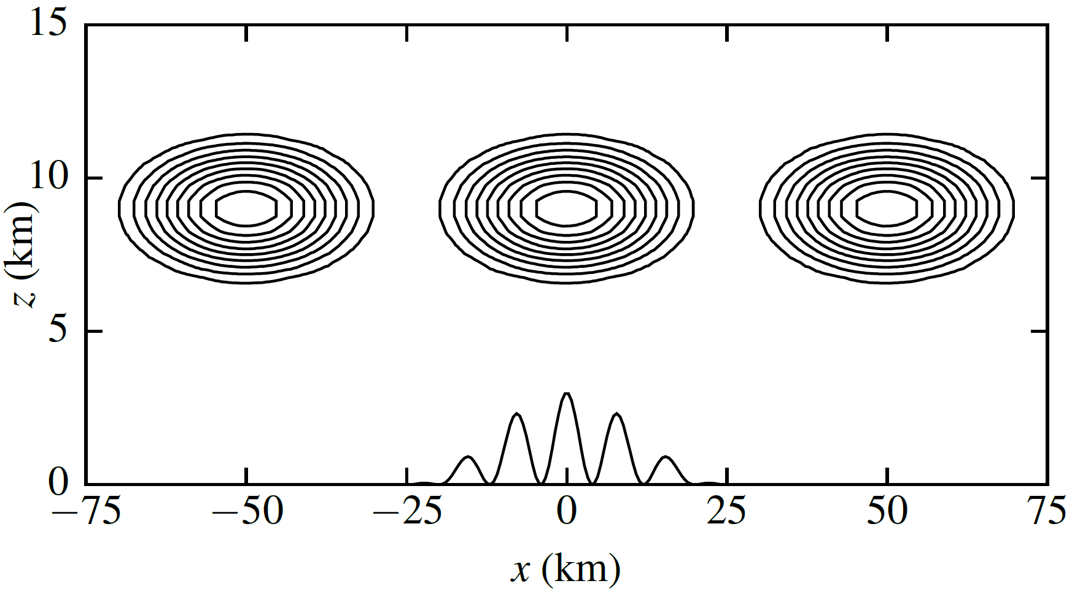
#1 Horizontal Tracer Advection Cut cell grid
Cubic upwind scheme on cut cell grid

Slide 26
#2 Terrain Following Advection

Slide 27
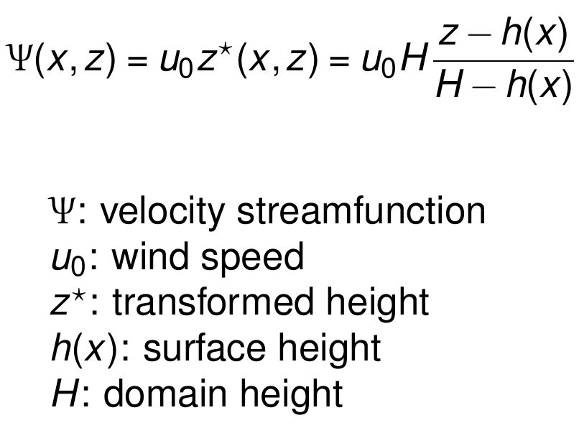
#2 Terrain Following Advection Velocity Field

Slide 28
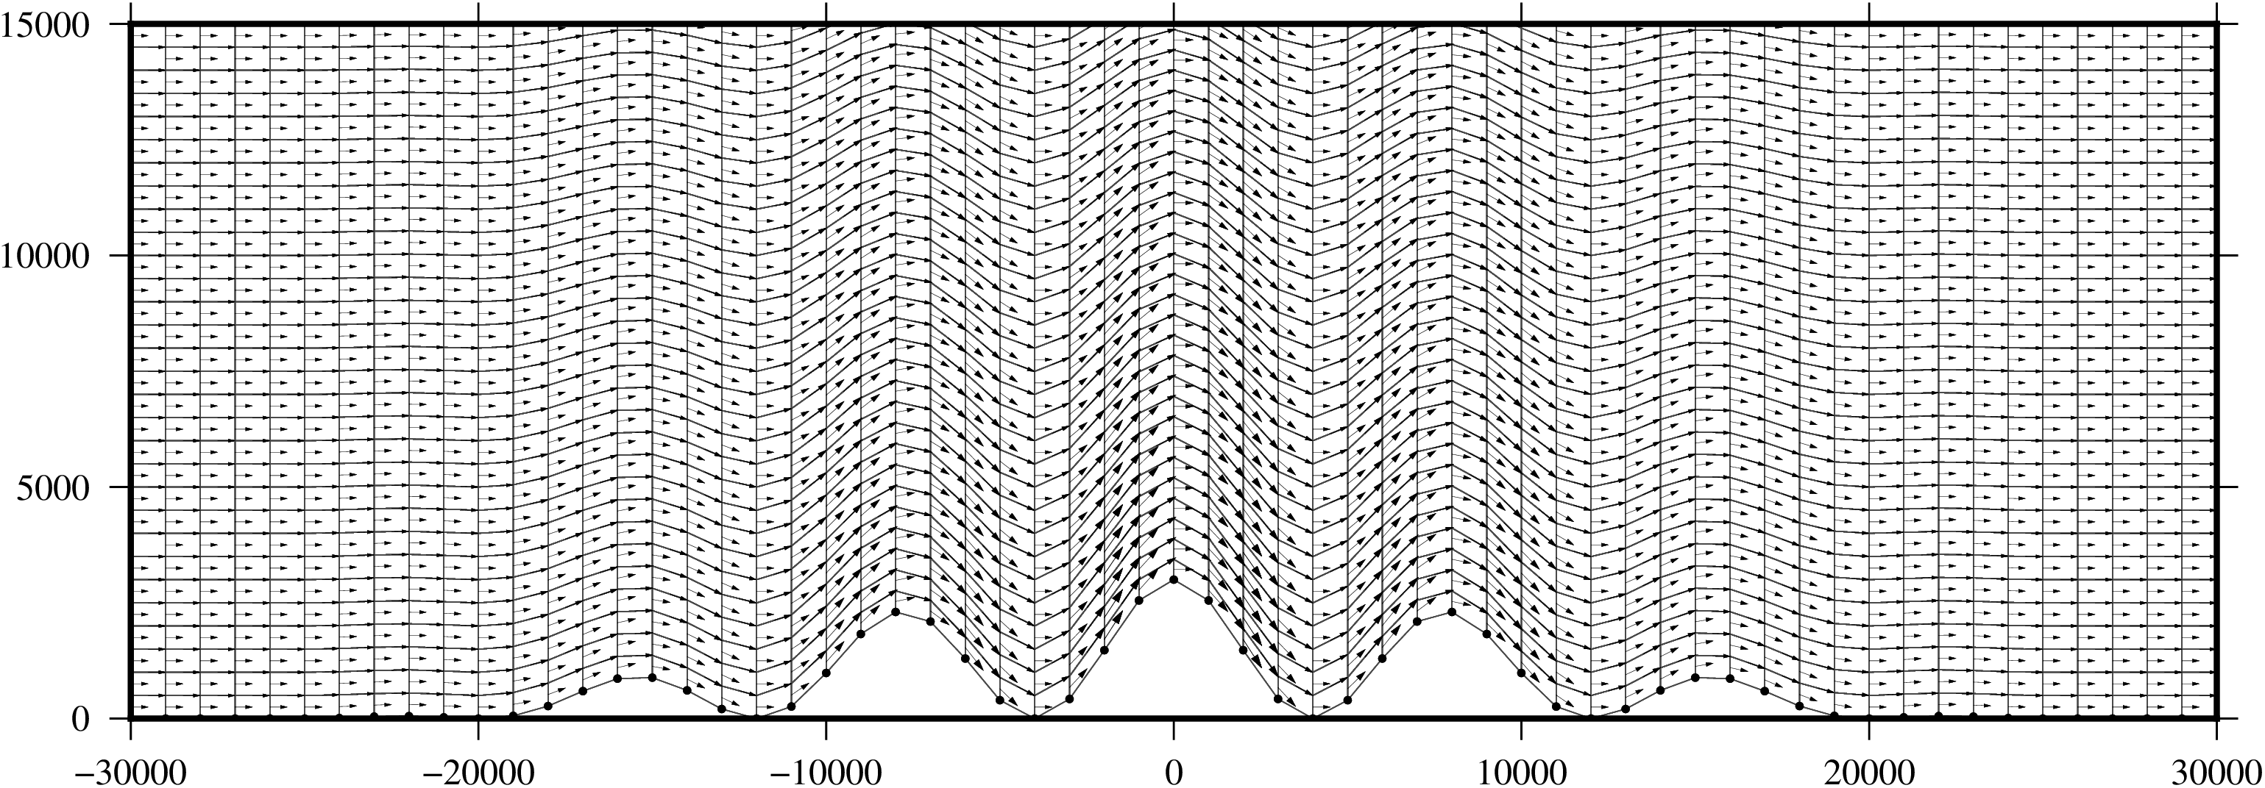
#2 Terrain Following Advection Velocity Field On BTF Grid

Slide 29
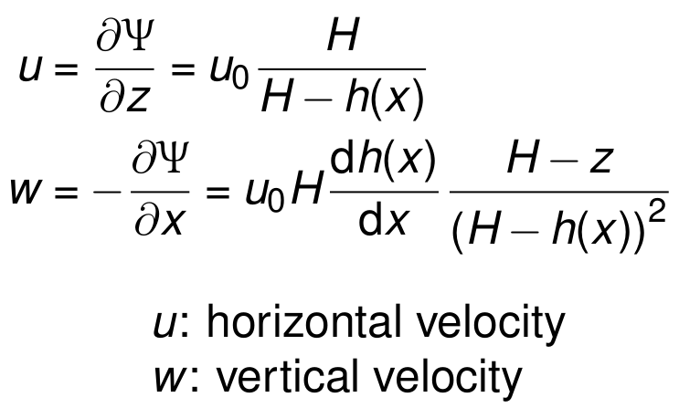
#2 Terrain Following Advection Analytic solution

Slide 30
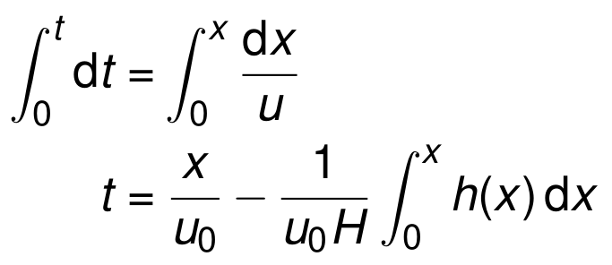
#2 Terrain Following Advection Analytic solution
⇒ Flow accelerates where h(x) > 0

Slide 31
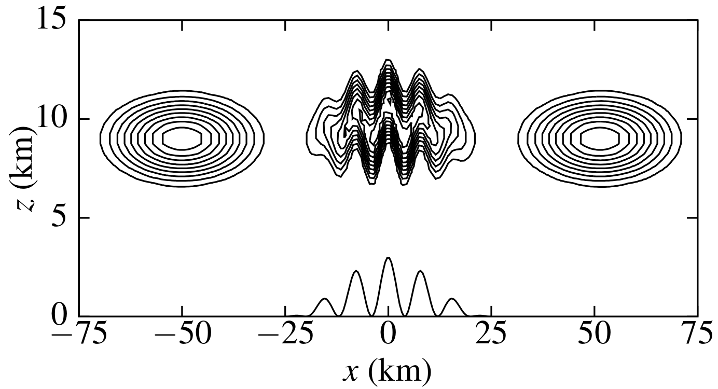
#2 Terrain following advection Basic terrain following grid

Slide 32
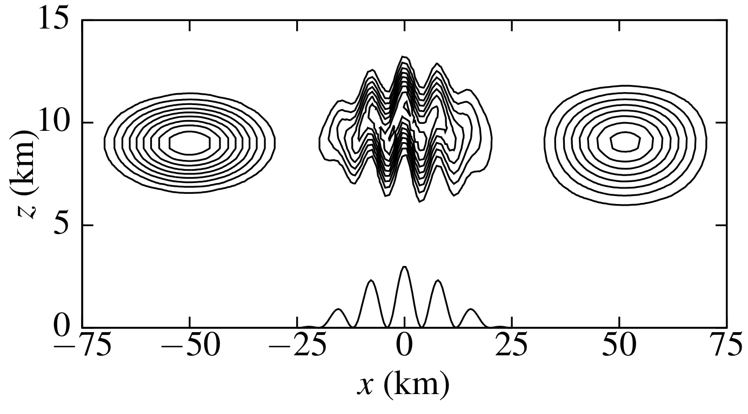
#2 Terrain following advection Cut cell grid

Slide 33
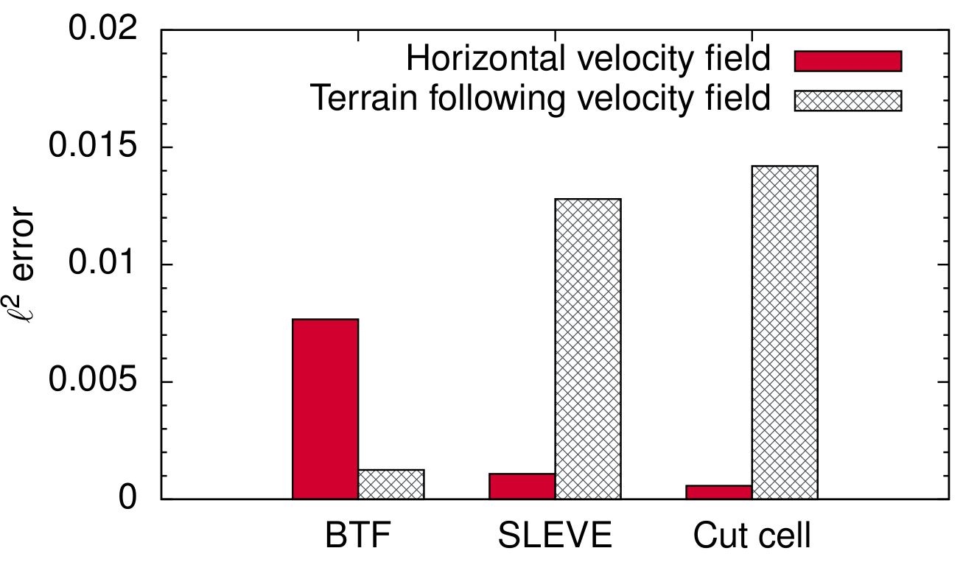
Summary of advection tests

Slide 34
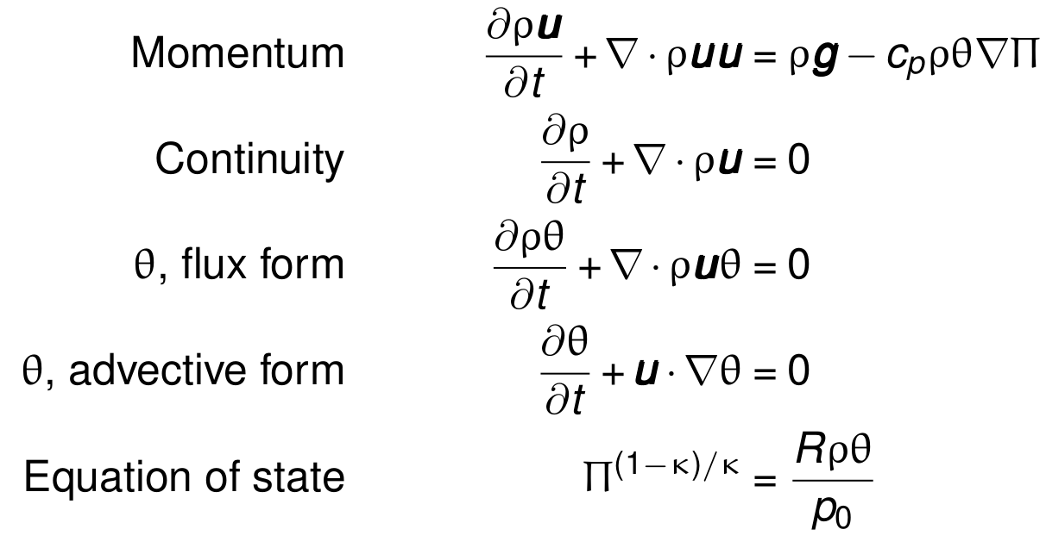
Euler Equation Set

Slide 35
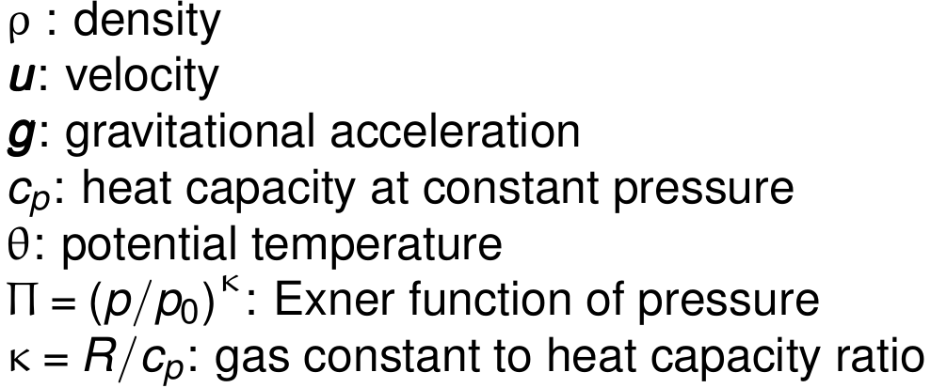
Euler Equation Set

Slide 36
Numerical Model features
Using model from Weller & Shahrokhi 2014 MWR
Fully-compressible finite volume model
Cubic upwind-biased, non-monotonic advection scheme
Curl-free pressure gradient formulation
Lorenz staggering of thermodynamic variables

Slide 37
#3 Resting atmosphere

Slide 38
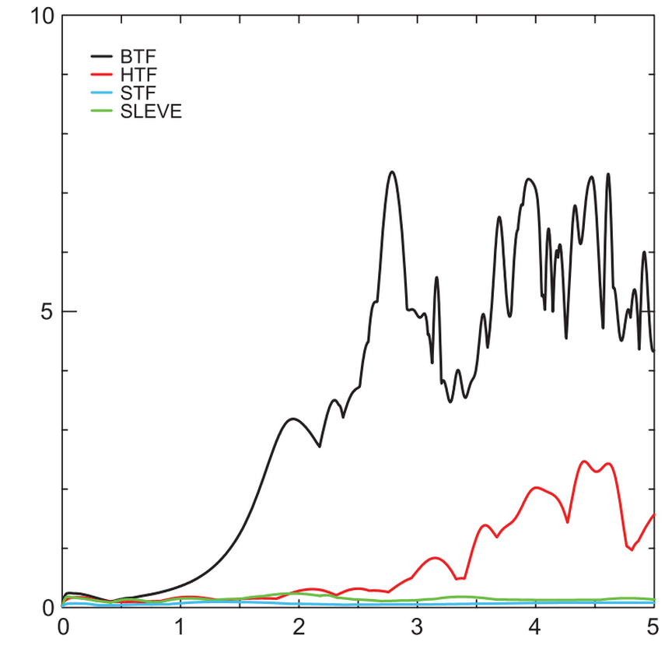
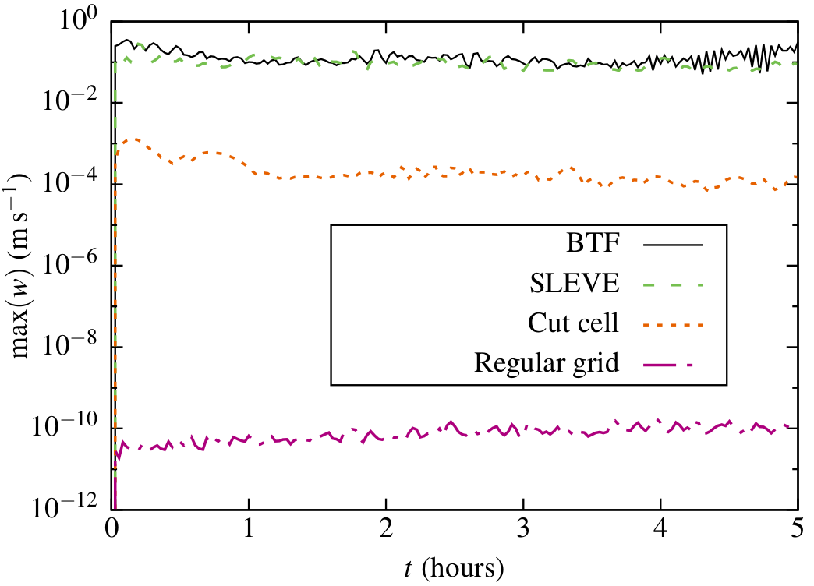
#3 Resting atmosphere
Spurious maximum vertical velocities
Klemp (2011) MWR

Slide 39
#4 Gravity Waves

Slide 40
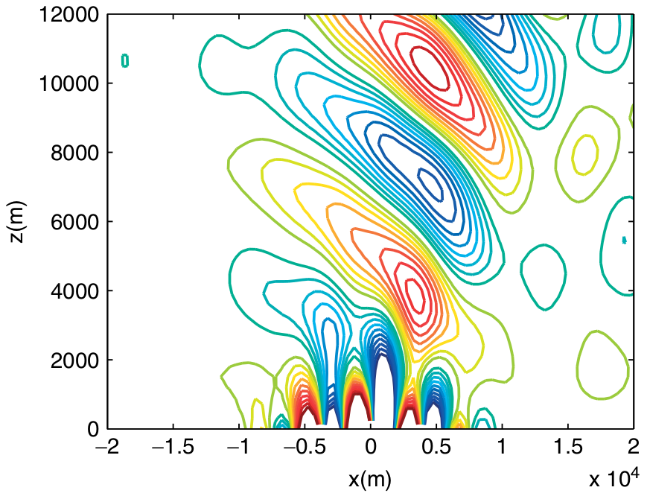
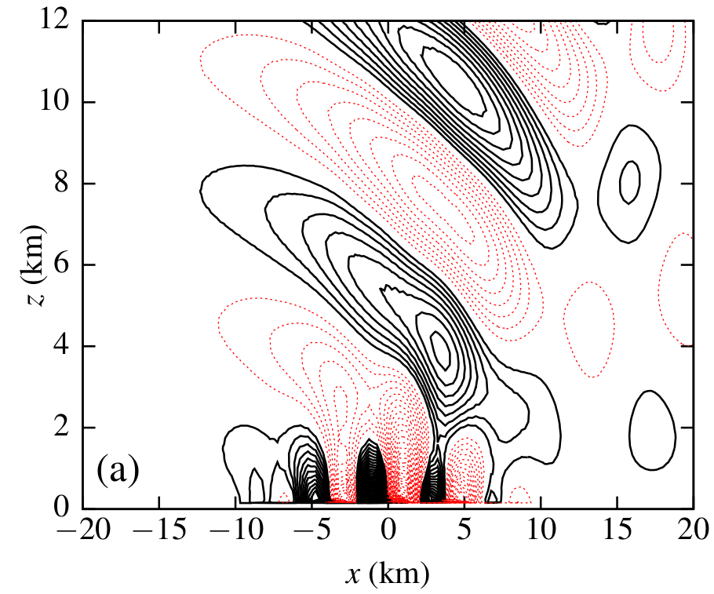
#4 Gravity Waves Basic Terrain Following Grid
Contours of vertical velocity
Melvin et al. (2010) QJRMS

Slide 41
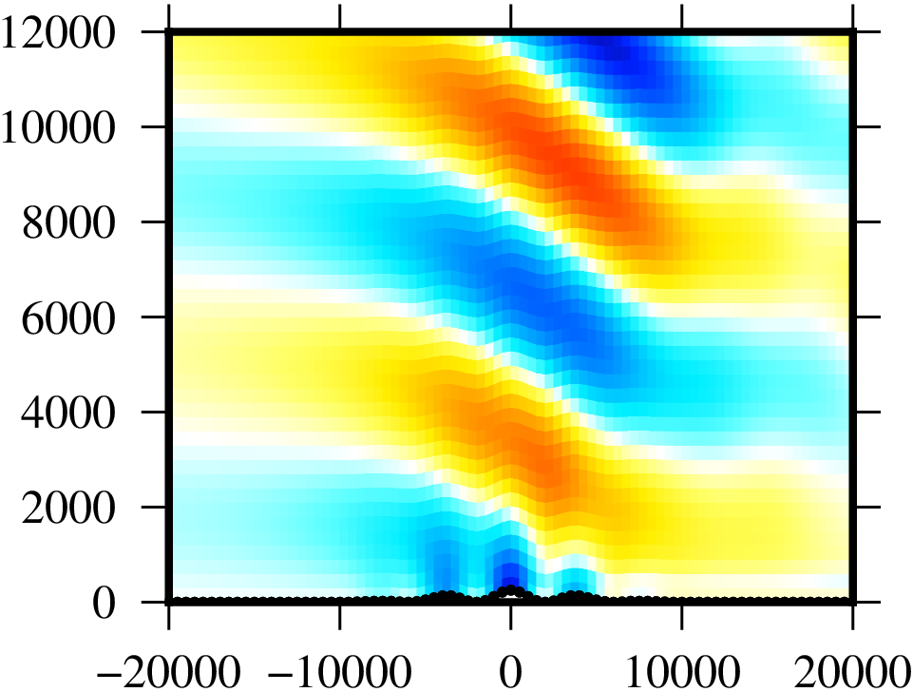
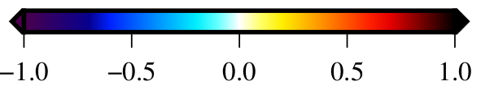
#4 Gravity Waves Basic terrain following Grid
Difference in potential temperature from initial conditions (K)

Slide 42

#4 Gravity Waves Cut cell grid
Difference in potential temperature from initial conditions (K)

Slide 43
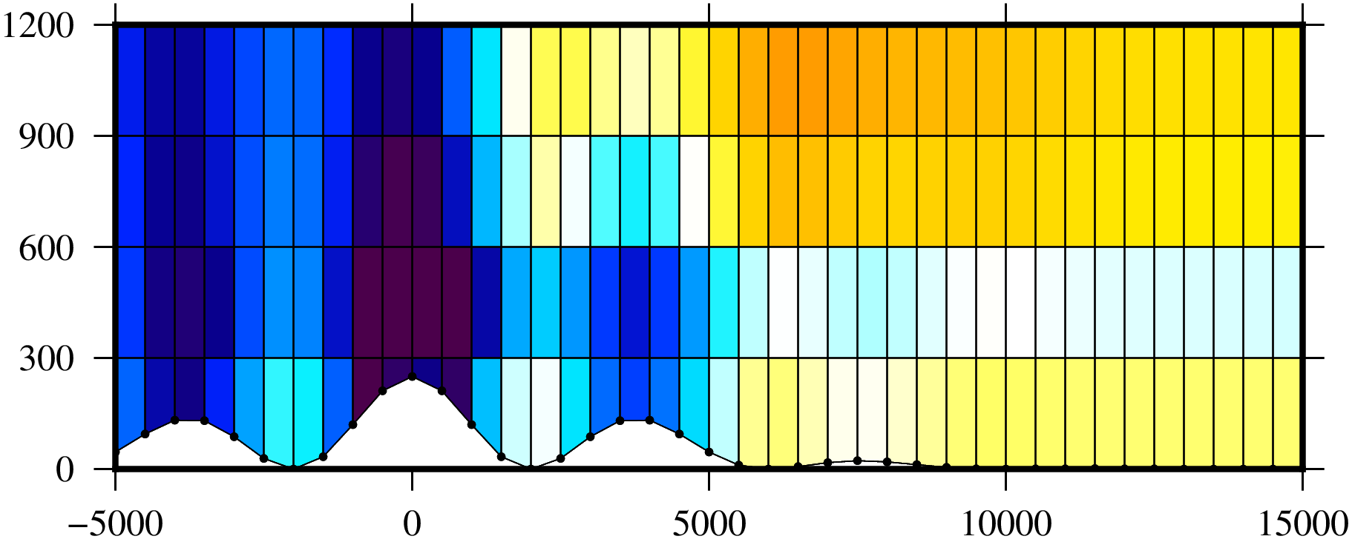
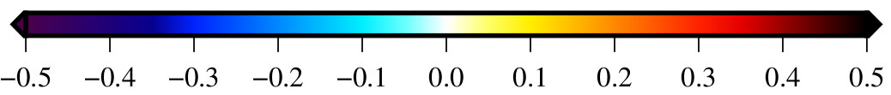
#4 Gravity Waves Cut cell grid

Slide 44
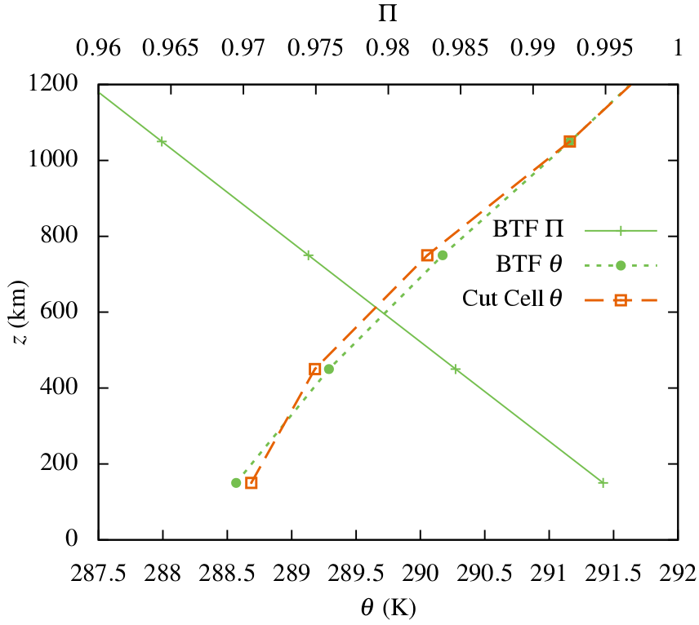
#4 Gravity Waves Lorenz Computational mode
Vertical sample line of Exner function of pressure (Π) and potential temperature (θ) on the lee side of the mountain

Slide 45
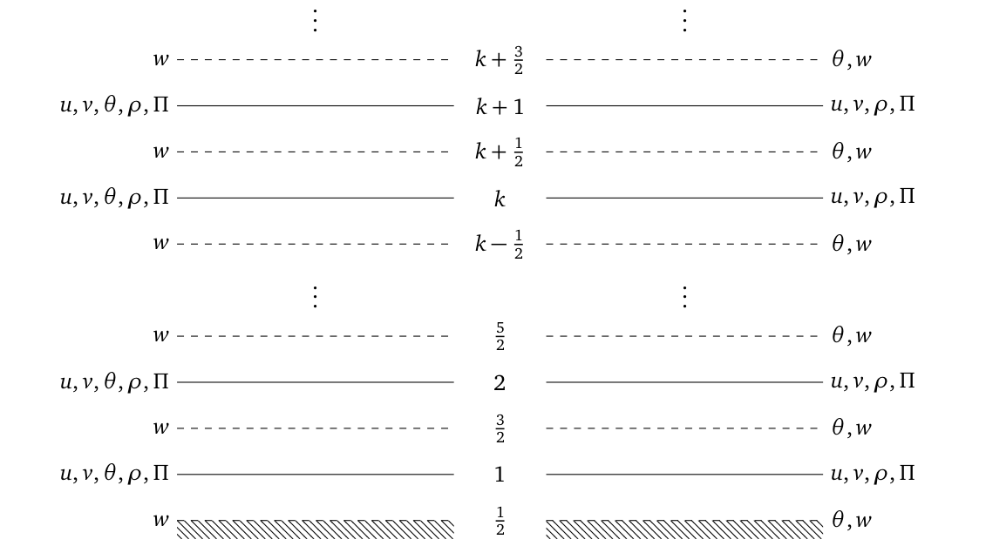
#4 Gravity Waves Lorenz Computational mode
Lorenz
Charney – Phillips

Slide 46
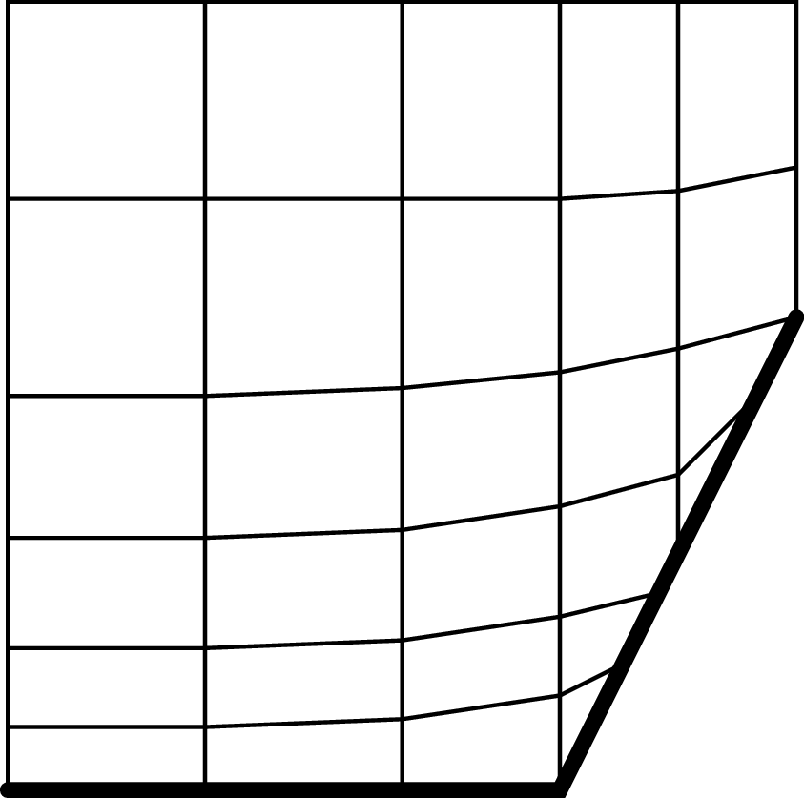
ConcLUSIONS
Similarly accurate results across all tests and all grids
Advection is most accurate when flow follows grid layers
Spurious velocities smallest in resting atmosphere on cut cell grid
Lorenz computational mode excited only on cut cell grid
Local mesh refinement
Terrain following/cut cell hybrid grid (below)
Mass coordinates using moving meshes
Charney–Phillips staggering on cut cell grid
further work

Slide 47
References
Adcroft, A., C. Hill and J. Marshall, 1997: Representation of topography by shaved cells in a height coordinate ocean model. Mon. Wea. Rev., 125, 2293–2315.
Gal-Chen, T. and R. C. Somerville, 1975: On the Use of a Coordinate Transformation for the Solution of the Navier-Stokes Equations. J. Comp. Phys., 17, 209–228.
Jebens, S., O. Knoth and R. Weiner, 2011: Partially implicit peer methods for the compressible Euler equations. J. Comp. Phys., 230, 4955–4974.
Klemp, J. B., 2011: A terrain-following coordinate with smoothed coordinate surfaces. Mon. Wea. Rev., 139, 2163–2169.
Leuenberger, D., M. Koller, O. Fuhrer and C. Schär, 2010: A Generalization of the SLEVE Vertical Coordinate. Mon. Wea. Rev., 138, 3683–3689.
Mahrer, Y., 1984: An Improved Numerical Approximation of the Horizontal Gradients in a Terrain-Following Coordinate System. Mon. Wea. Rev., 112, 918–922.
Melvin, T., M. Dubal, N. Wood, A. Staniforth and M. Zerroukat, 2010: An inherently mass-conserving iterative semi-implicit semi-Lagrangian discretization of the non-hydrostatic vertical-slice equations. Quart. J. Roy. Meteor. Soc., 136, 799–814

Slide 48
References
Mesinger, F., Z. I. Janjić, S. Ničkovic, D. Gavrilov and D. G. Deaven, 1988: The step-mountain coordinate: Model Description and Performance for Cases of Alpine Lee Cyclogenesis and for a Case of an Appalachian Redevelopment. Mon. Wea. Rev., 116, 1493–1518.
Schär, C., D. Leuenberger, O. Fuhrer, D. Lüthi and C. Girard, 2002: A new terrain-following vertical coordinate formulation for atmospheric prediction models. Mon. Wea. Rev., 130, 2459–2480.
Simmons, A. J. and D. M. Burridge, 1981: An energy and angular-momentum conserving vertical finite-difference scheme and hybrid vertical coordinates. Mon. Wea. Rev., 109, 758–766.
Steppeler, J., H.-W. Bitzer, M. Minotte and L. Bonaventura, 2002: Nonhydrostatic Atmospheric Modeling using a z-Coordinate Representation. Mon. Wea. Rev., 130, 2143–2149.
Steppeler, J., S.-H. Park, A. Dobler, 2013: Forecasts covering one month using a cut-cell model. Geosci. Model Dev., 6, 875–882.
Weller, H. and A. Shahrokhi, 2014: Curl-Free Pressure Gradients over Orography in a Solution of the Fully Compressible Euler Equations with Implicit Treatment of Acoustic and Gravity Waves. Mon. Wea. Rev., 142, 4439–4457.
Yamazaki, H. and T. Satomura, 2010: Nonhydrostatic Atmospheric Modeling Using a Combined Cartesian Grid. Mon. Wea. Rev., 138, 3932–3945.

